Slide 1
Amazon Home Services Introducting AsapTutor
Presenter: Charles Ding

Slide 2


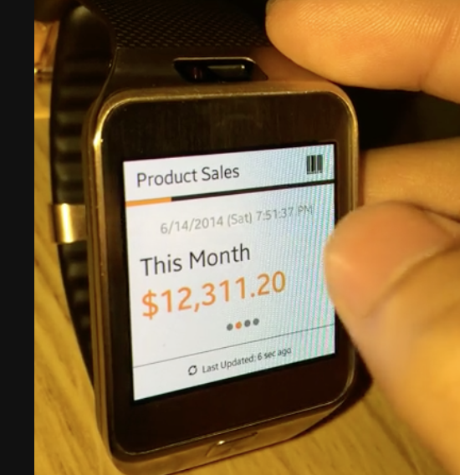
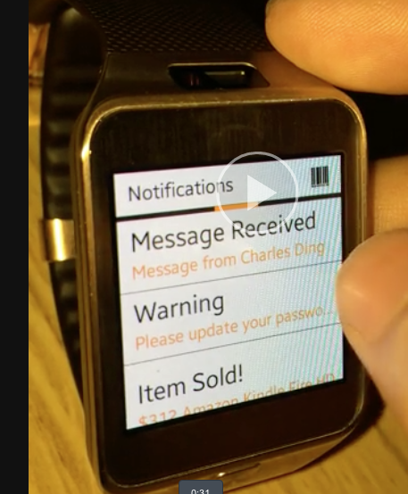
Brief Introductions
My name @dincheng
I Interned with Amazon Summer in the Amazon Seller Mobile Team ’14 to create smart watch app.
I graduated this past May and started working full-time at Amazon since.

Slide 3



What is AsapTutor?
An "uber-like” platform with tradition scheduling options where people go to buy/sell academia services in real-time.

Slide 4
Major Features Overview
Real-time tracking and real-time visual cues
Real-time status updates/notifications for Mobile and Web
Chatting Functionality
Emergency “ASAP” Button
User Rating
Credit-Card and PayPal Payment Processing
Flexible Scheduling

Slide 5
Major Features Overview
Real-time tracking and real-time visual cues
Real-time status updates/notifications for Mobile and Web
Chatting Functionality
Emergency “ASAP” Button
User Rating
Credit-Card and PayPal Payment Processing
Flexible Scheduling
Notes:
User Rating Scheduling, and Payment Processing already exist at Amazon, so I will skip over those. Mention that you will go right to Demo after this.

Slide 6
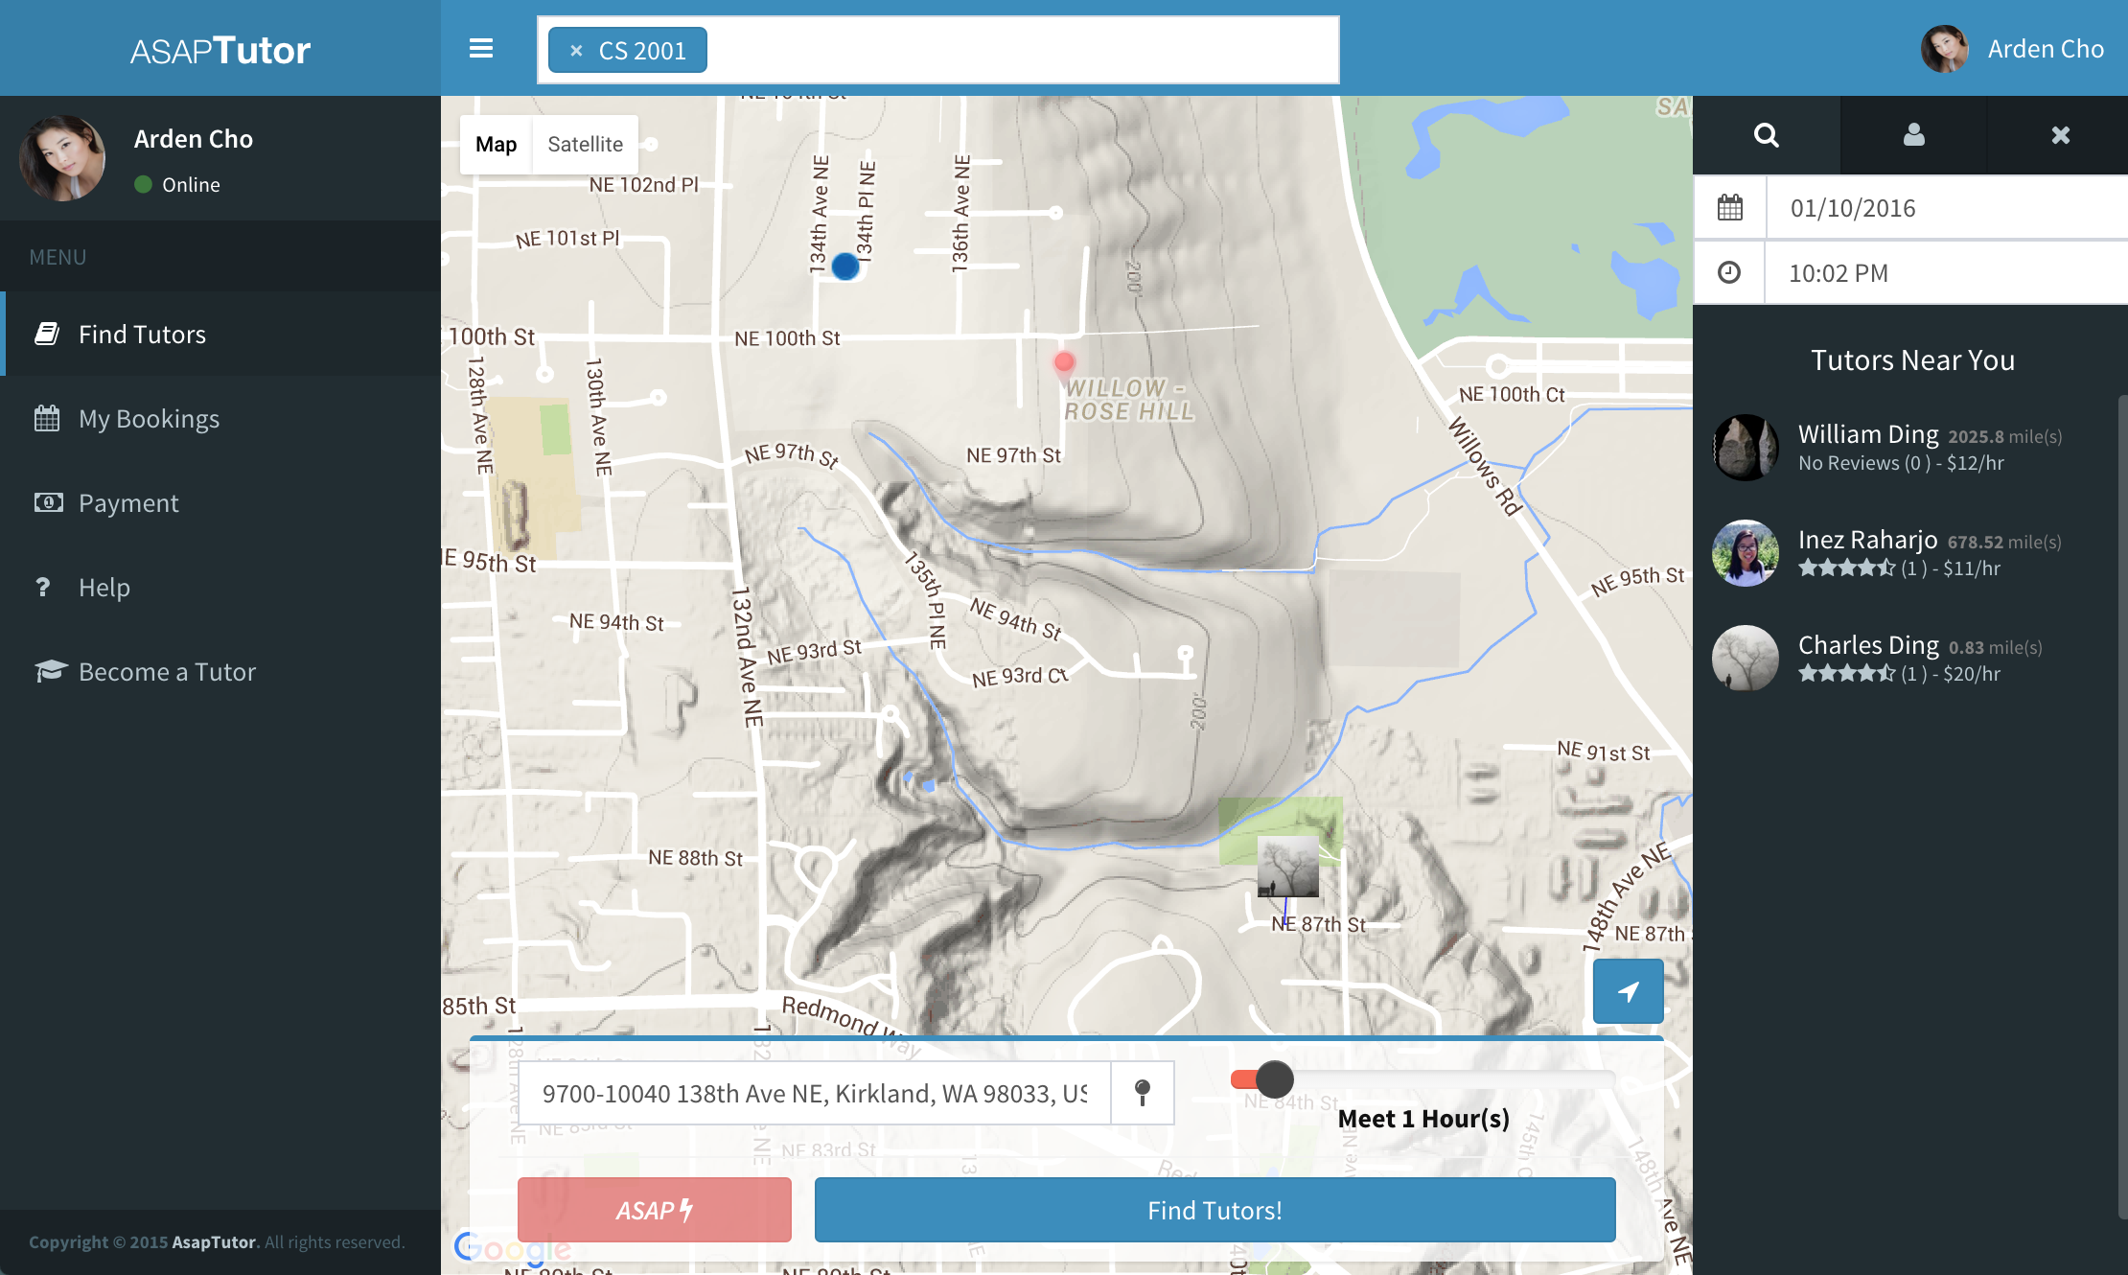


Real-time tracking and real-time visual cues
You are here (Blinking)
Meeting Location
Tutor Location
Locations will be updated in Real-time

Slide 7
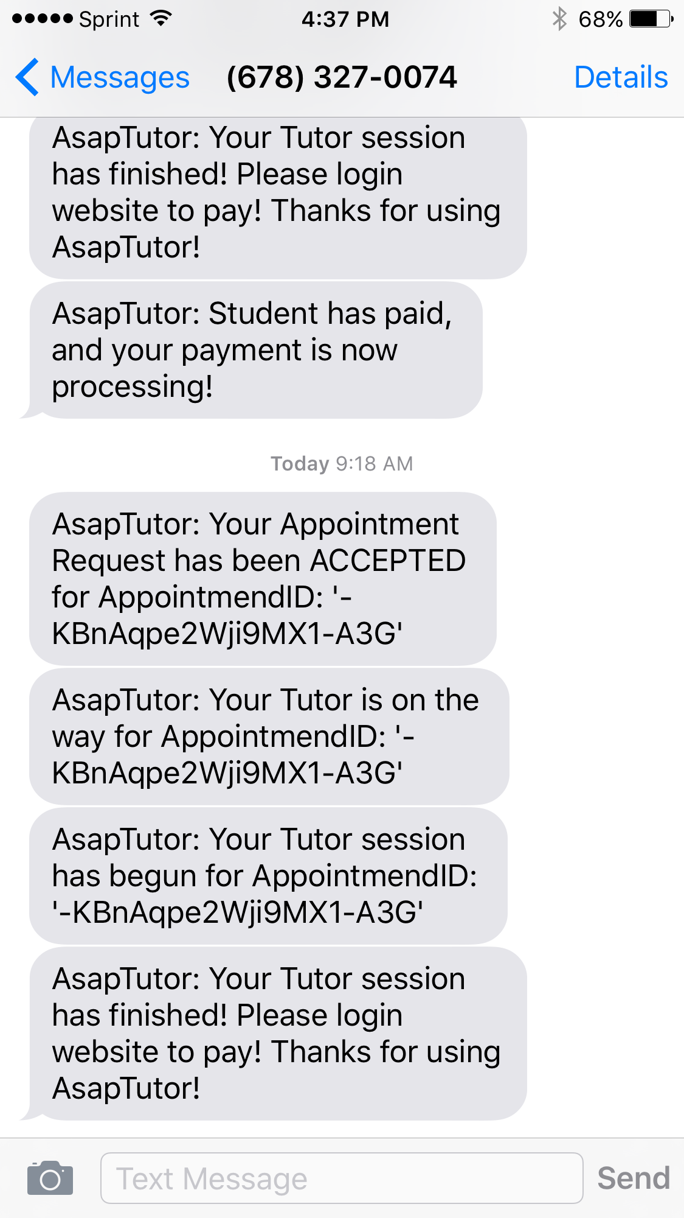
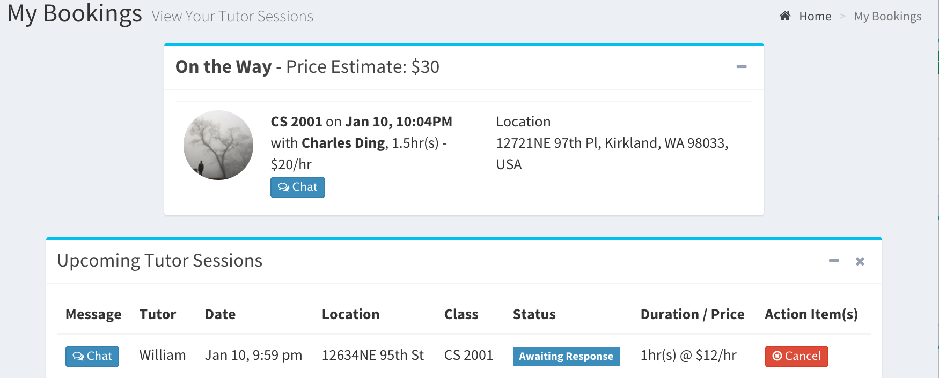
Real-time status updates/notifications for Mobile and Web
The moment the status changes in our database, it is immediately reflected onto the website with the need to refresh the page
Get texts/emails directly to your mobile device.

Slide 8
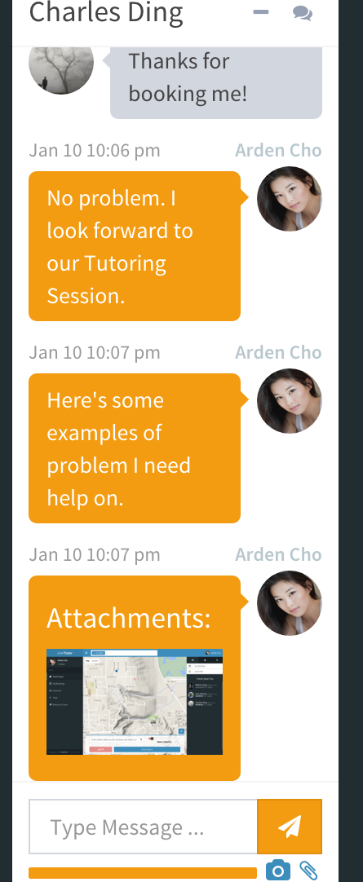

Chatting Functionality
Chat and send documents/pictures to each other before your session
Everything is stored on AWS S3

Slide 9

College Student Procrastination
Imagine you are a college student and you just found out midterms are tomorrow. What can you do?

Slide 10
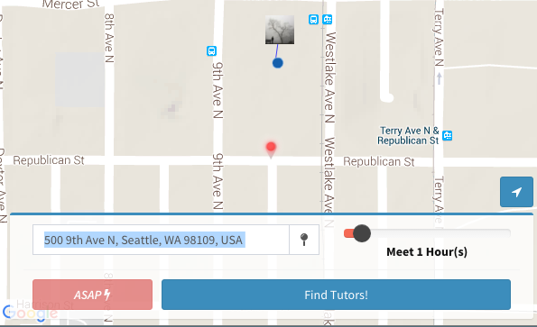
Introducing the Emergency Button “ASAP”
As the name suggests, this gets a tutor as soon as possible.
Reaches out to all the tutors online or offline to find you help immediately, but at a higher cost.
SOS!
Notes:
Similar to MayDay Concept for the Kindles.

Slide 11
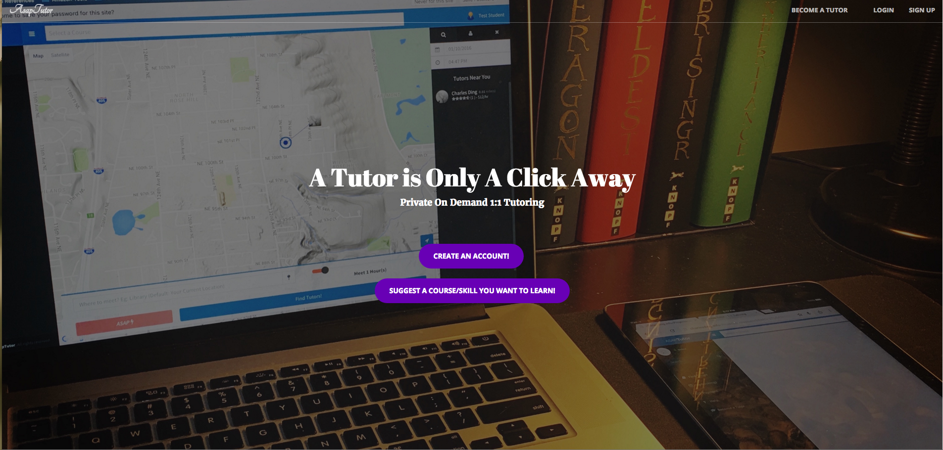
DEMO
Student Perspective: http://asaptutor.us/homePage.html
Tutor Perspective: http://asaptutor.us/tutor.html

Slide 12

Extensibility
For now, this focuses on Academia services, but can be easily extended to any type of service

Slide 13









AsapTutor Cutting Edge Technologies
Amazon EC2 Instance Running NodeJS Server
AWS CloudFront and AWS Route 53 – Web Hosting
AWS S3 – Chatting Storage
SendGrid – Email Notifications
Twillio – Mobile Notifications
Braintree – Secure Payment Integration
Firebase – Real-time Database Management
Notes:
I know AWS has SNS, but my use cases are not supported. I’ve separately suggested to them feature requests.

Slide 14

Questions?
Our "secret sauce" will lie in the "ASAP" Button, which is the equivalent of 911 for academic needs.
We have what other companies in this area lacks - a fully functional web-based platform
We made the entire process dead simple more so than them or any other competitor. Sign-up/Verified within seconds.
Notes:
More info on our competitor Tutree: http://www.startuppanel.co/uber-for-tutoring-just-launched-and-its-awesome/

